Slide 1





February 16-19, 2024

Slide 2


Slide 3

Free online course with Bird Academy

Slide 4

Count birds wherever you like
Backyards
Patios/Porches
City Streets
Parks
Nature Centers
Anywhere!
People birding in Uttarakhand, India by Ankush Chowdhury

Slide 5
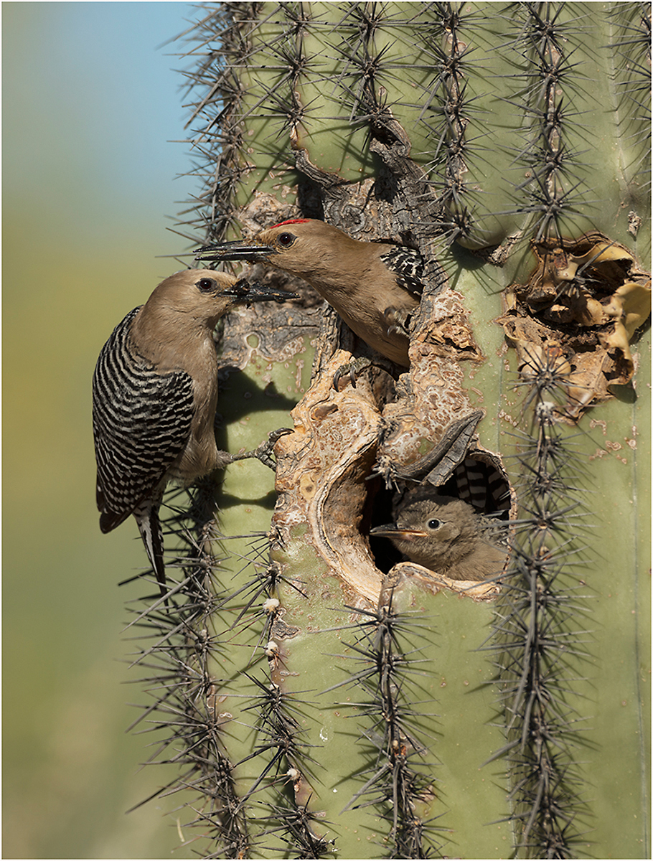
Why participate?
Make sure your birds are counted
Long-term record of birds
Scientists can’t be everywhere, all the time
It’s fun and connects you to nature
Gila Woodpeckers

Slide 6
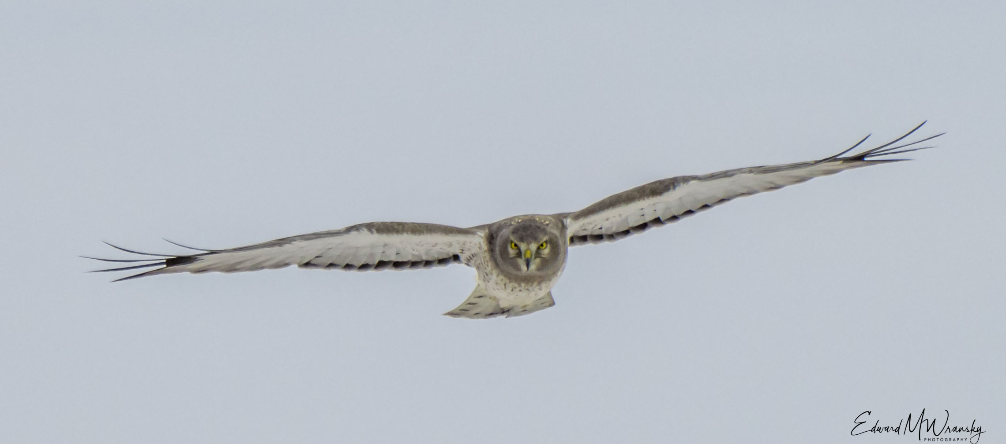
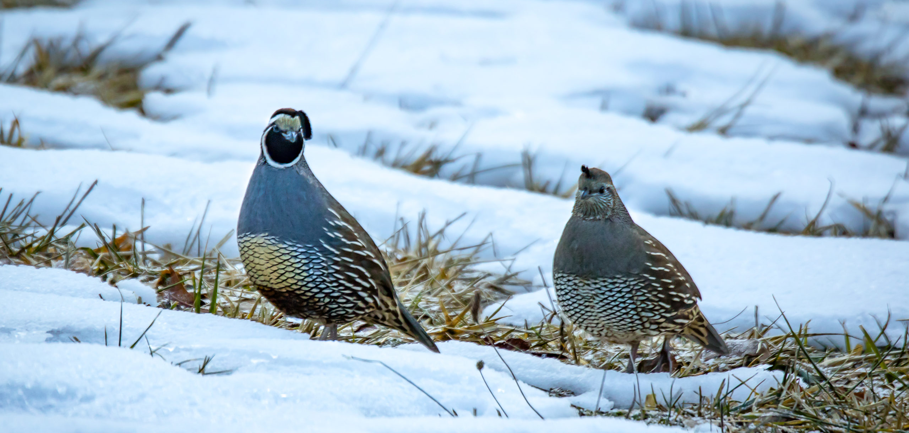
You Can…
Participate from anywhere in the world
Access personal bird lists
Use your account to report birds year round
Life lists and records
Northern Harrier above; California Quail below

Slide 7
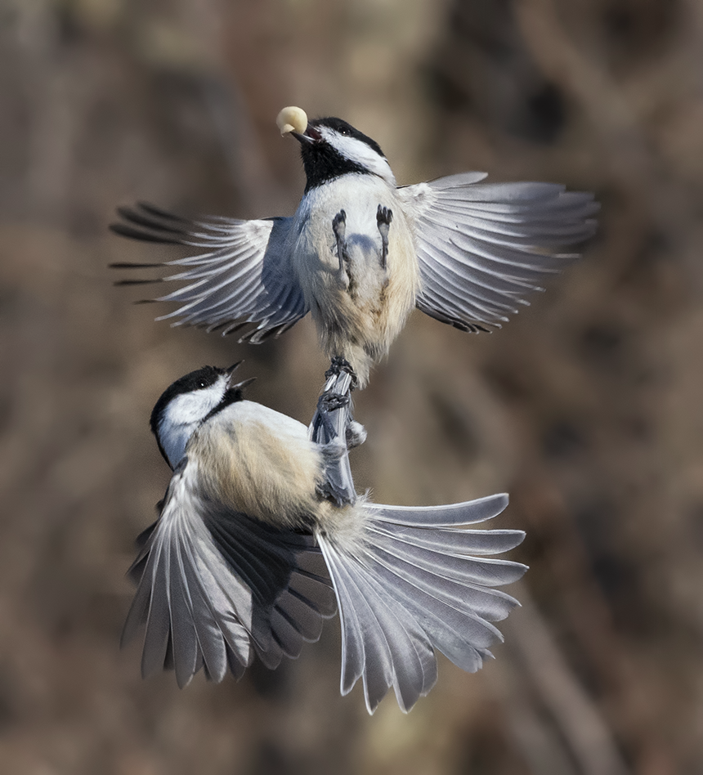
What do we learn?
Migration patterns
Year-to-year changes
Long-term trends
Black-capped Chickadees

Slide 8
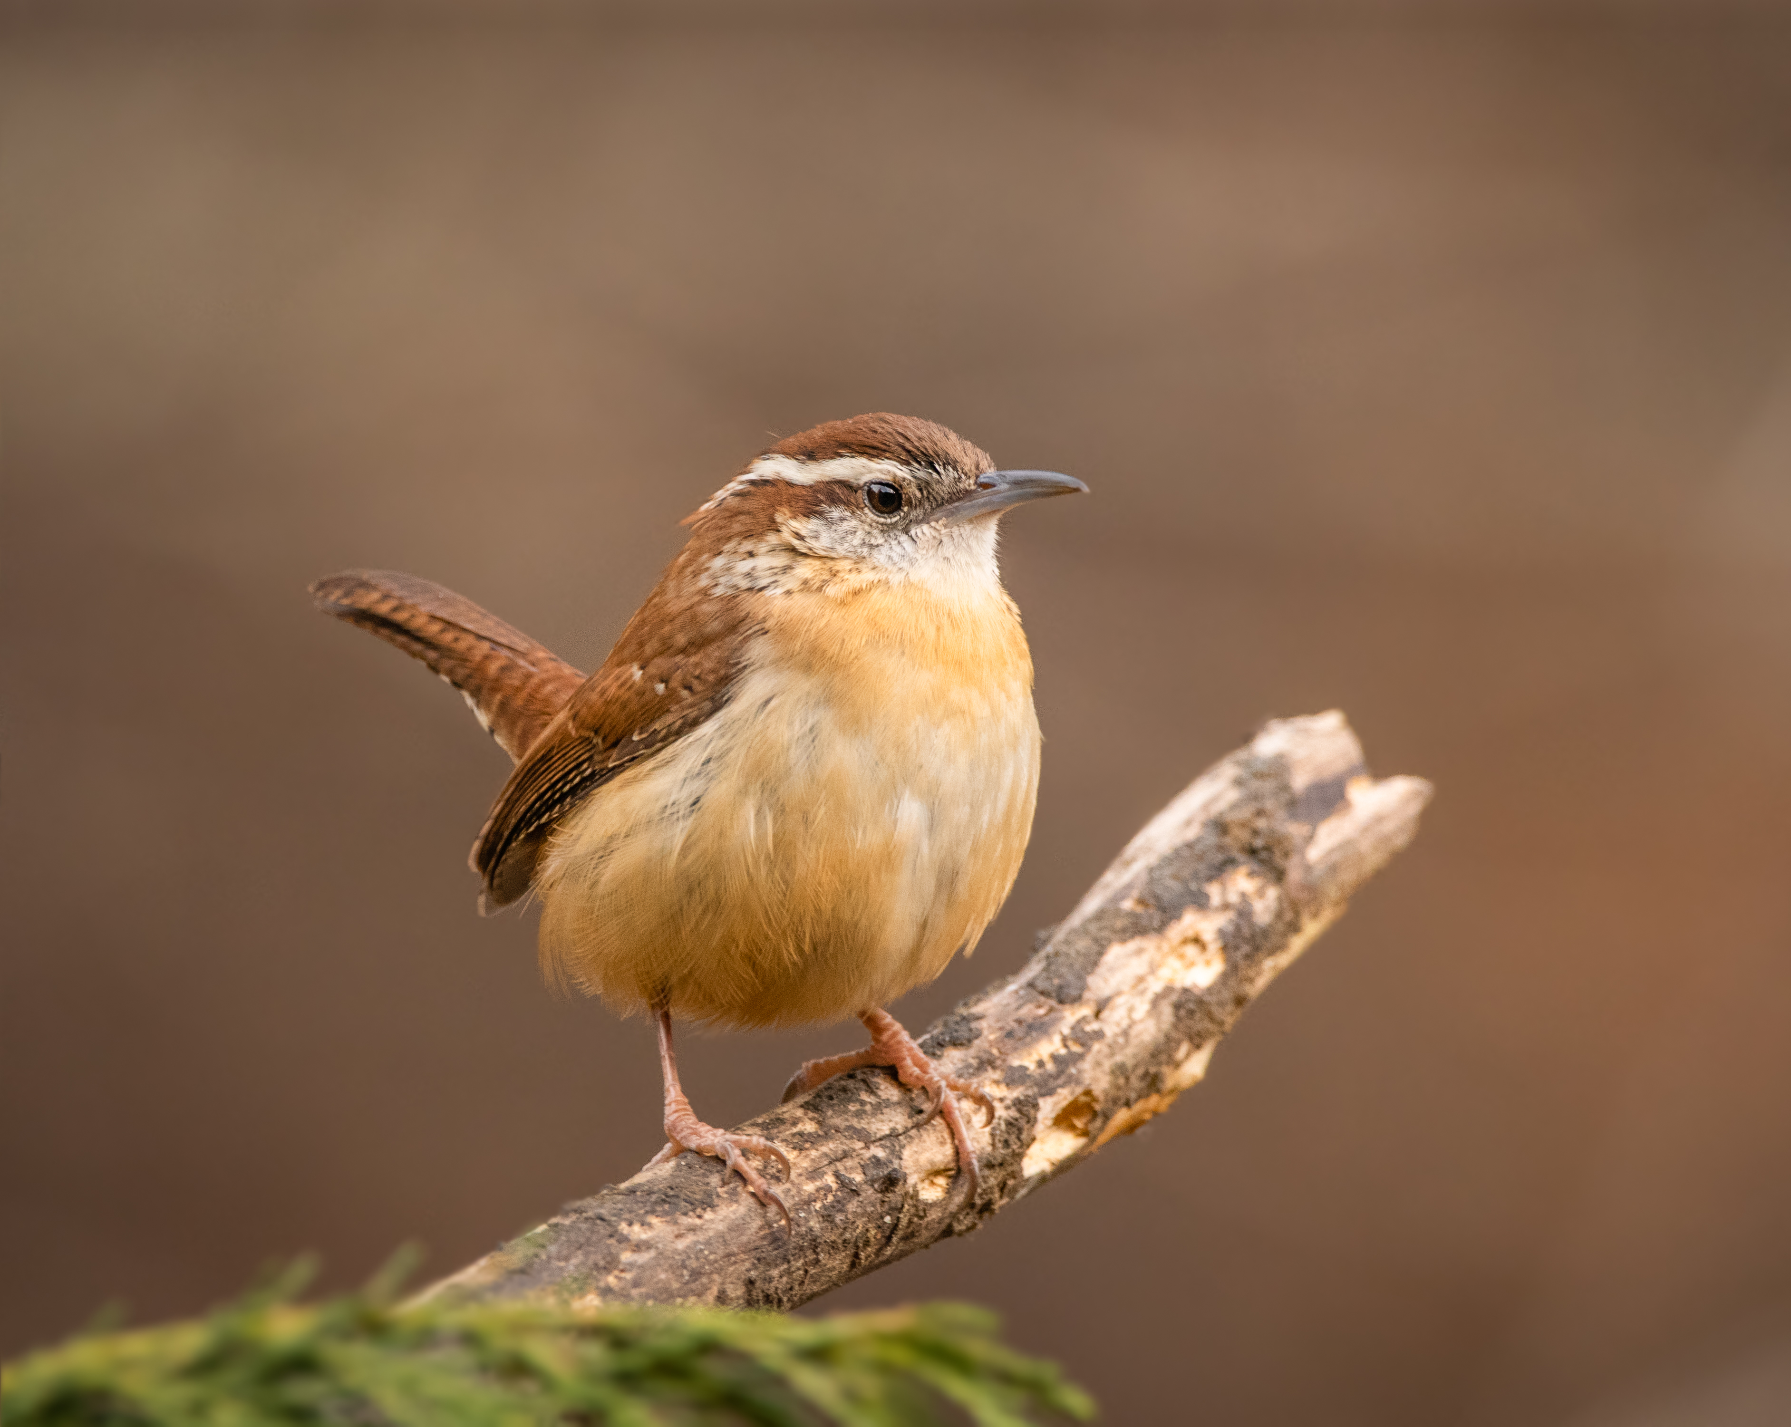
What do you do?
Count birds anywhere for at least 15 minutes
Count longer if you wish!
Keep track of time
Best estimate on the number of individuals for each species observed
Carolina Wren

Slide 9
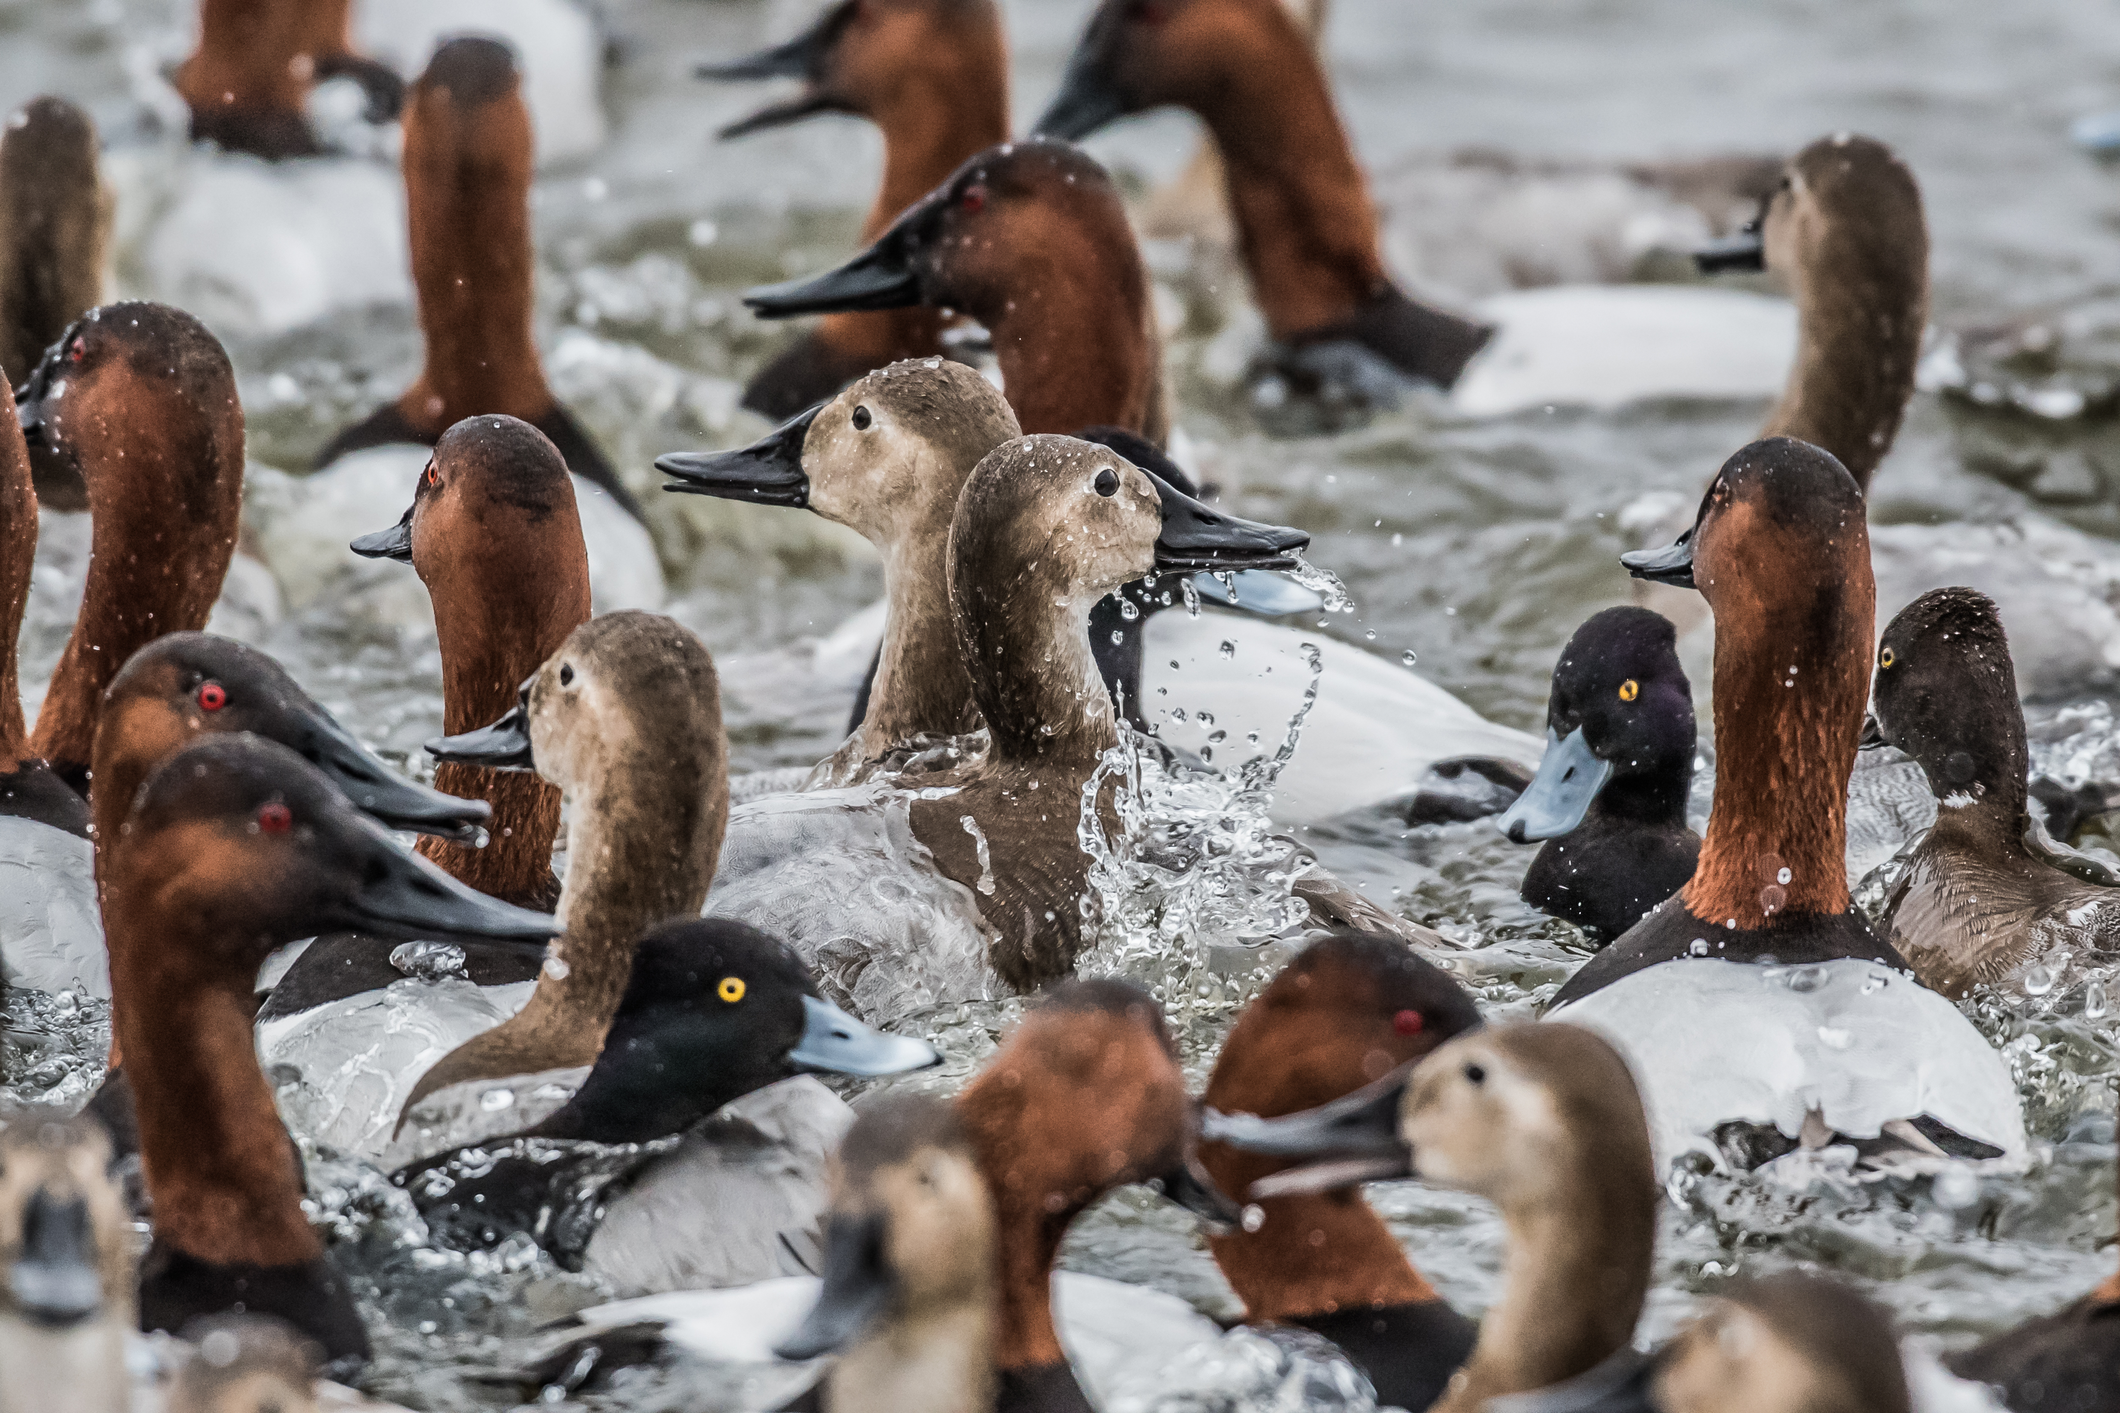
You will need….
New checklist for each day
New checklist for each new location
New checklist for same place, new time
Canvasbacks and lesser Scaups by Laura Fraizer

Slide 10
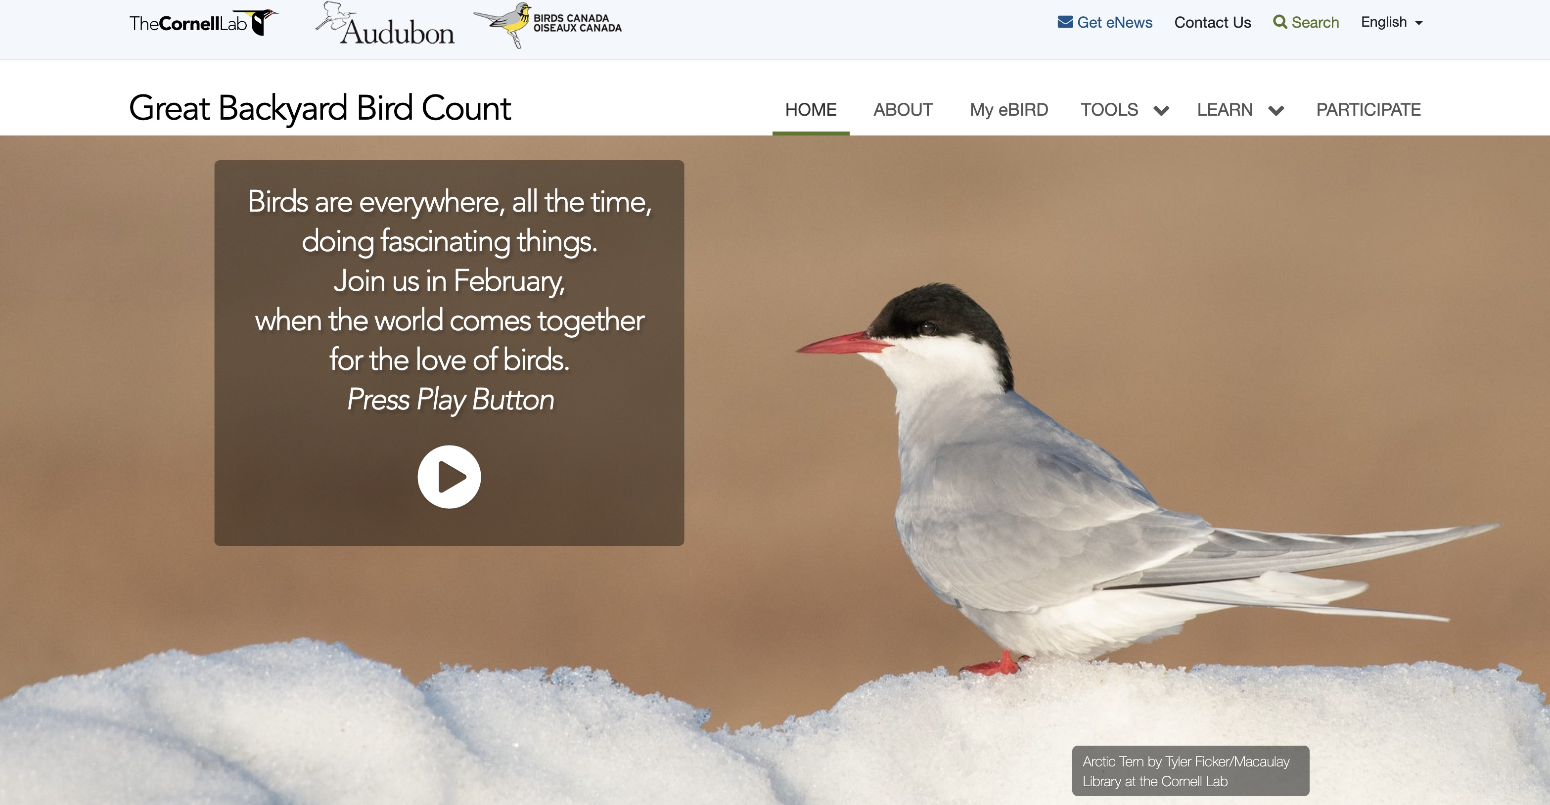
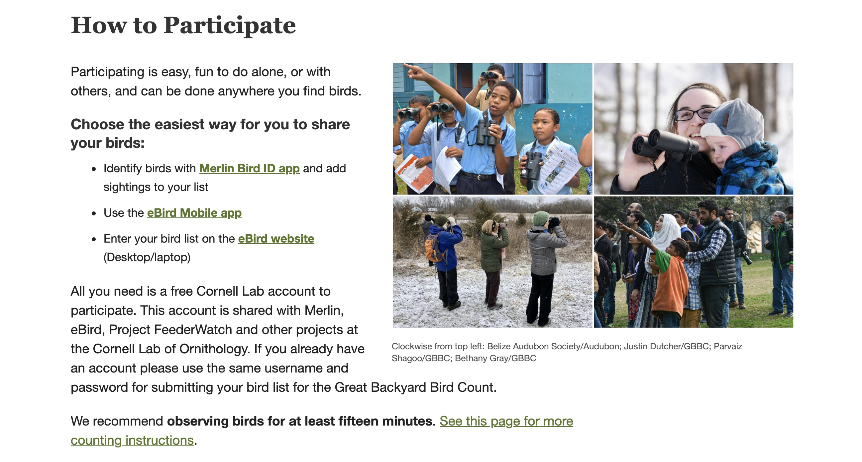
Enter counts @ birdcount.org

Slide 11
Important!
Create an account if you are new to the Great Backyard Bird Count or have not participated since before 2013.
If you already participate in other Cornell Lab projects such as; eBird, Merlin, FeederWatch, NestWatch, etc., enter that username and password.
ALL sightings reported to eBird over the weekend and saved bird IDs in Merlin count towards the count.

Slide 12
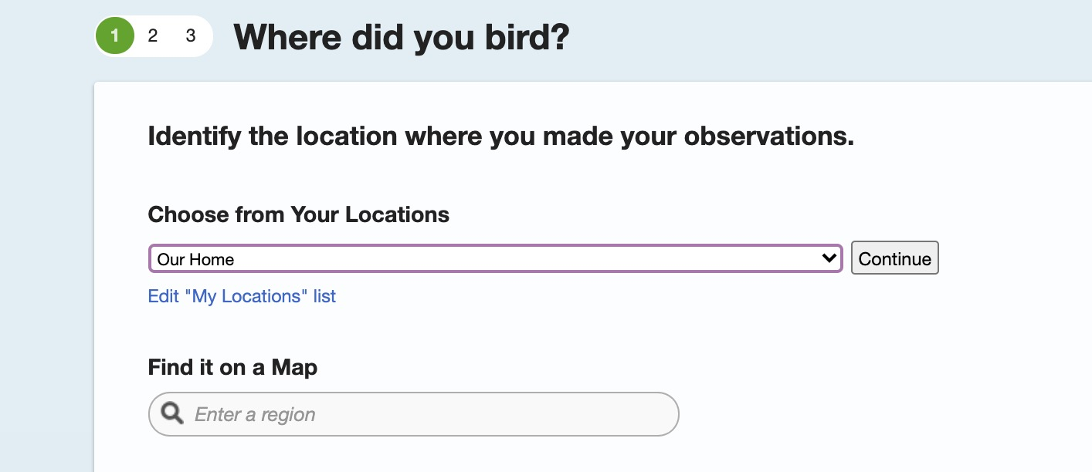
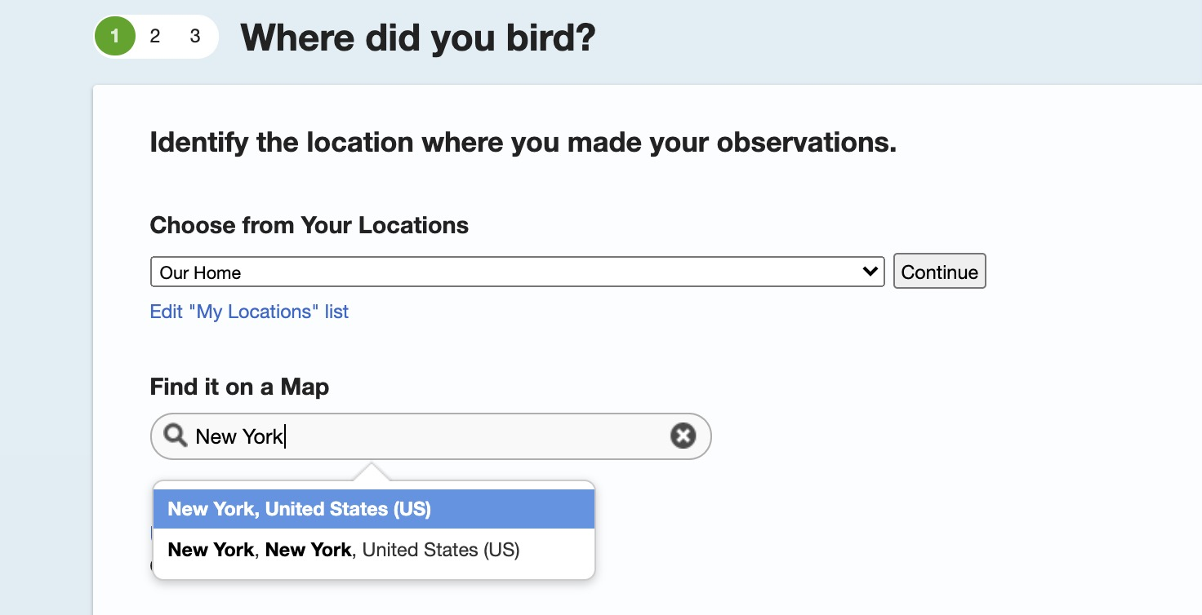

Slide 13
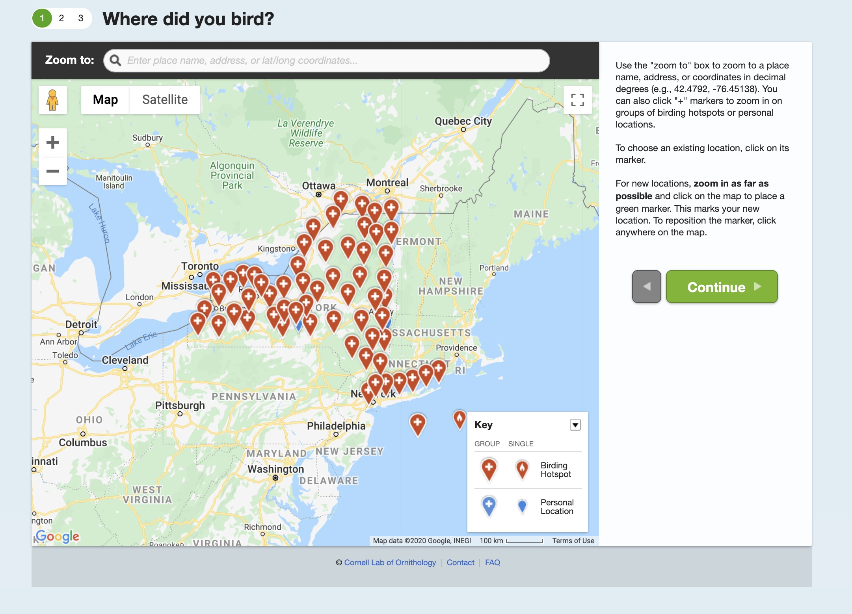

Slide 14
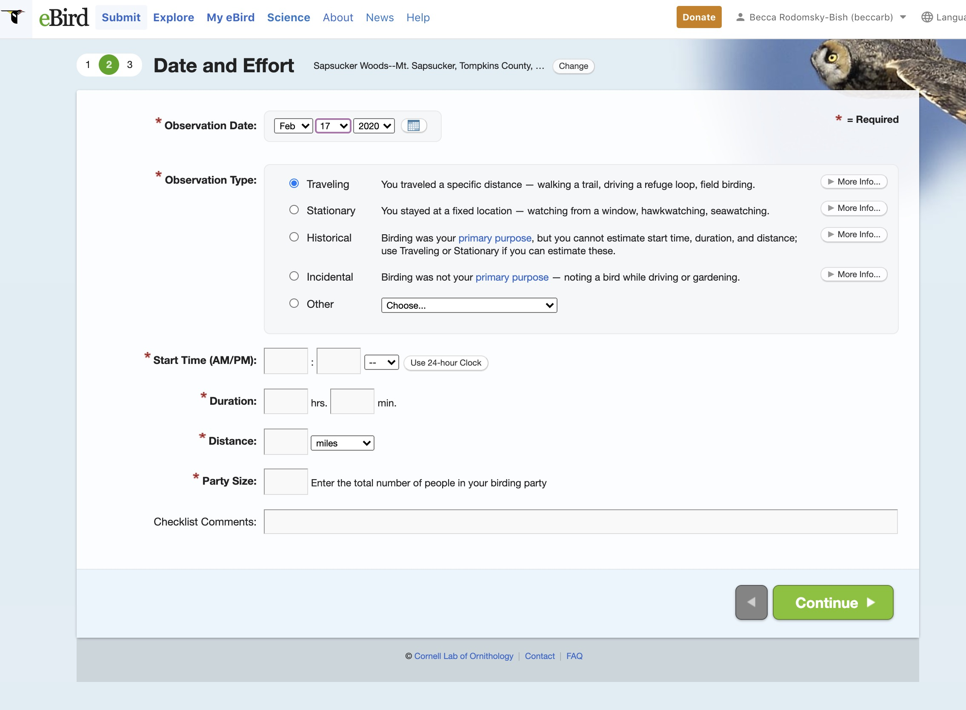

Slide 15
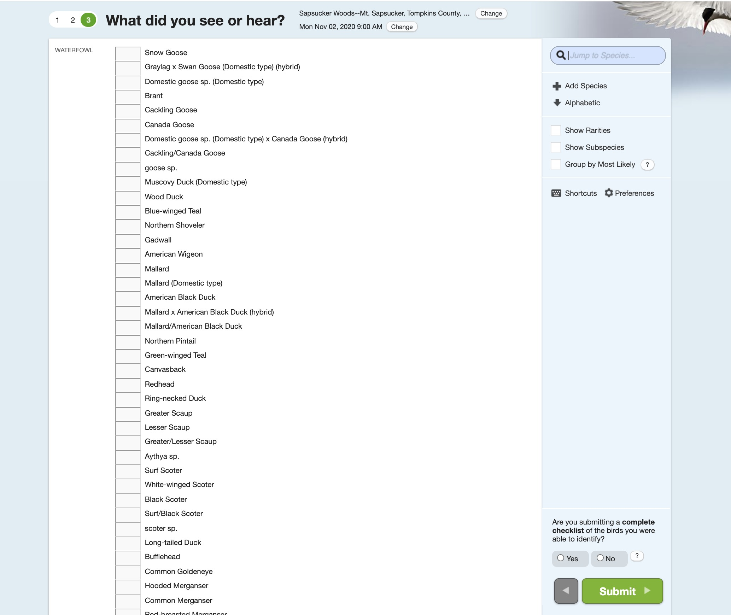

Slide 16
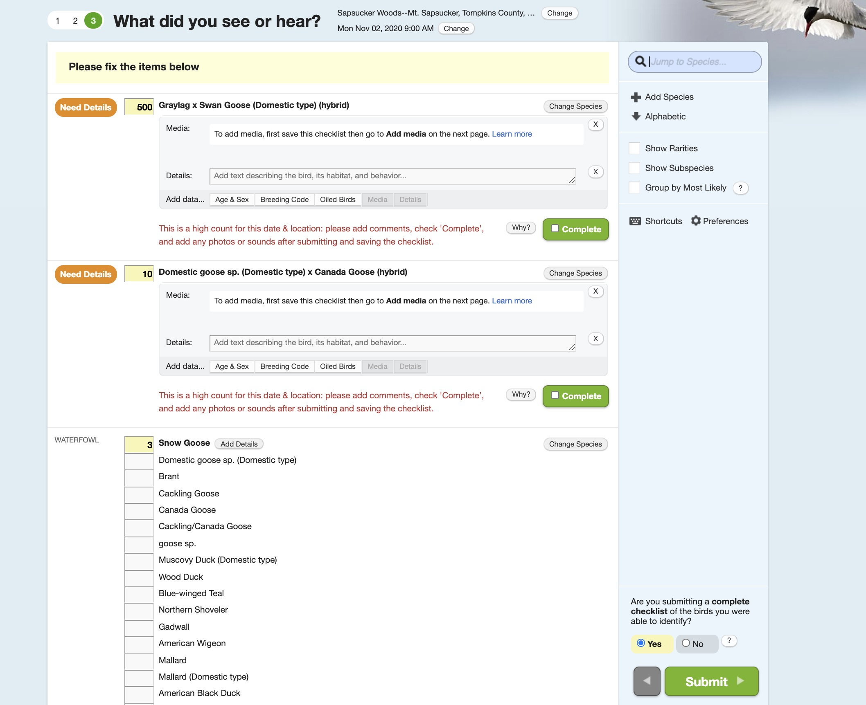

Slide 17
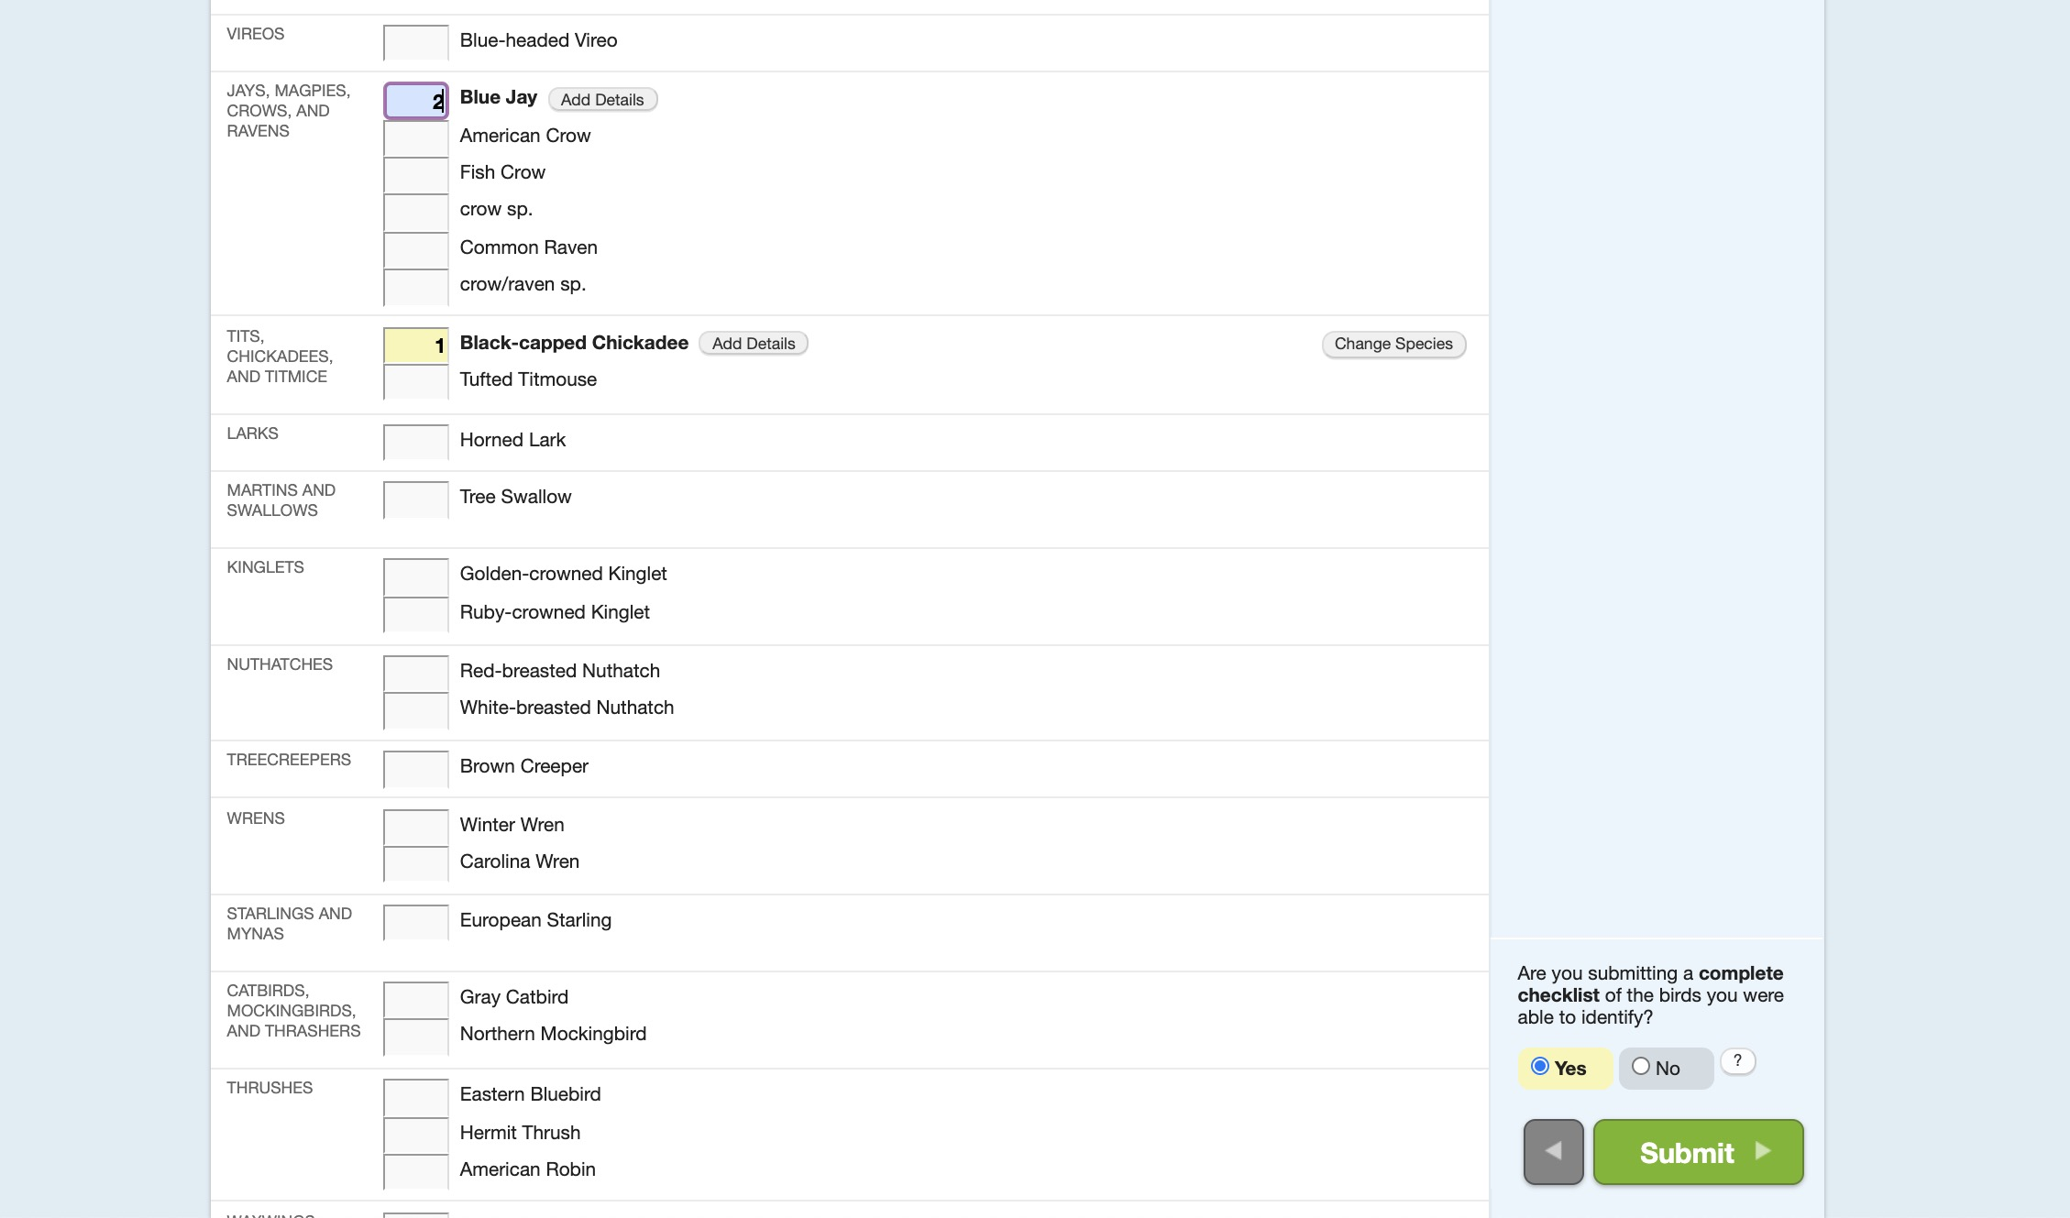

Slide 18
After you submit your count, you can:
Review and edit the list
Share your list with others who compiles the list (if group)
Submit another list
Tufted Titmouse

Slide 19
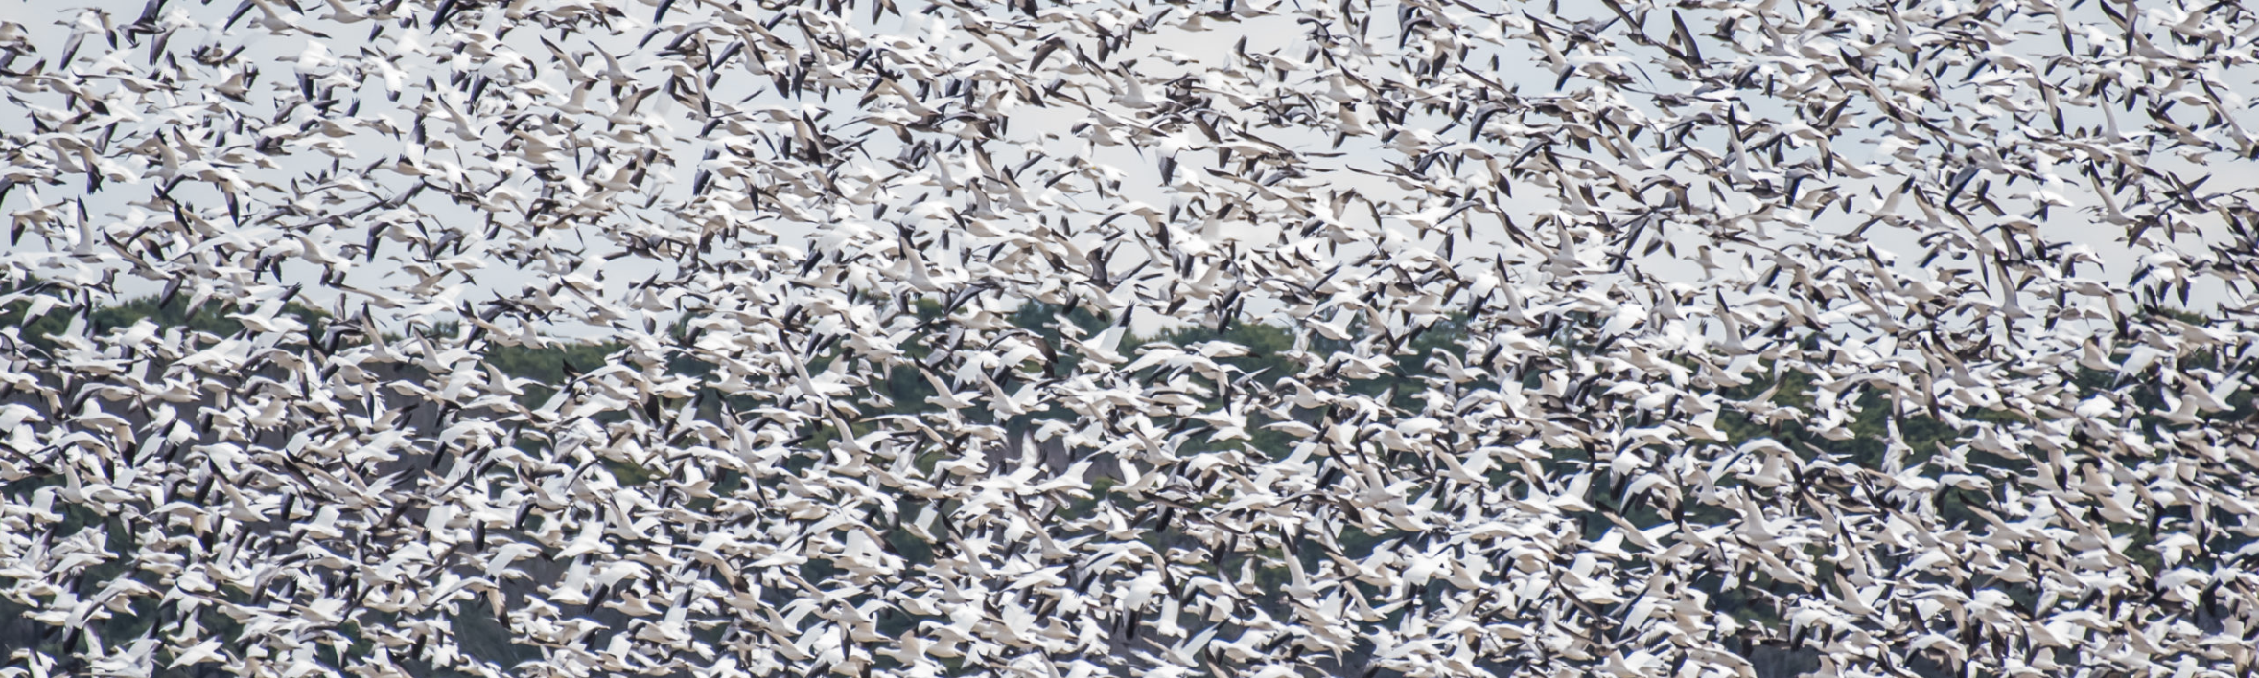
Join us for the Great Backyard Bird Count!
www.birdcount.org
Snow Geese

Slide 20
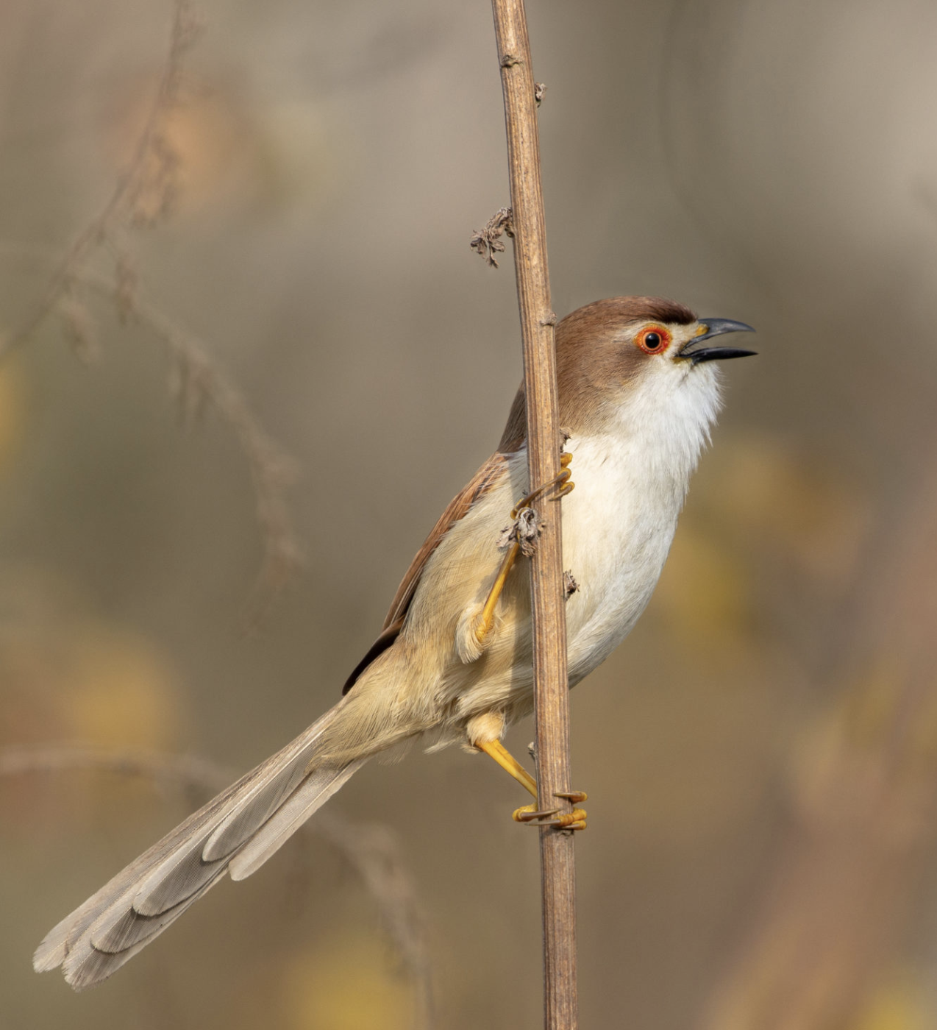
All photos by GBBC participants
People birding by Ankush Chowdhury
Gila Wood peckers by Andrew Byerly
Northern Harrier by Ed Wransky
California Quail by Patricia Ediger
Black-capped Chickadees by Jocelyn Anderson
Carolina Wren by Jenny Burdette
Canvasbacks and lesser Scaups by Laura Fraizer
Tufted Titmouse by Jenny Burdette
Snow Geese by Laura Fraizer
Yellow-eyed Babbler by Ankush Chowdhury
Yellow-eyed Babbler

