Slide 1
The Great Backyard Bird Count
Four days of bird-fun! February 14-17, 2025
American Oystercatchers by Michael Stubblefield / Macaulay Library
Andrea Hinek in Colombia / GBBC

Slide 2
The Great Backyard Bird Count (GBBC) Is Global!
People from all over the world join this four-day event.
Chetan Sumukha, India; Michael Carion, Hawaii, U.S.; Paula Brown, Canada; Talatu Tende in Nigeria.
The Great Backyard Bird Count

Slide 3
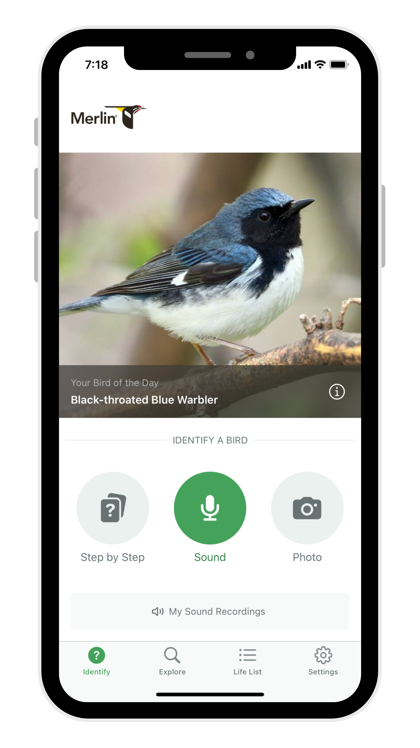
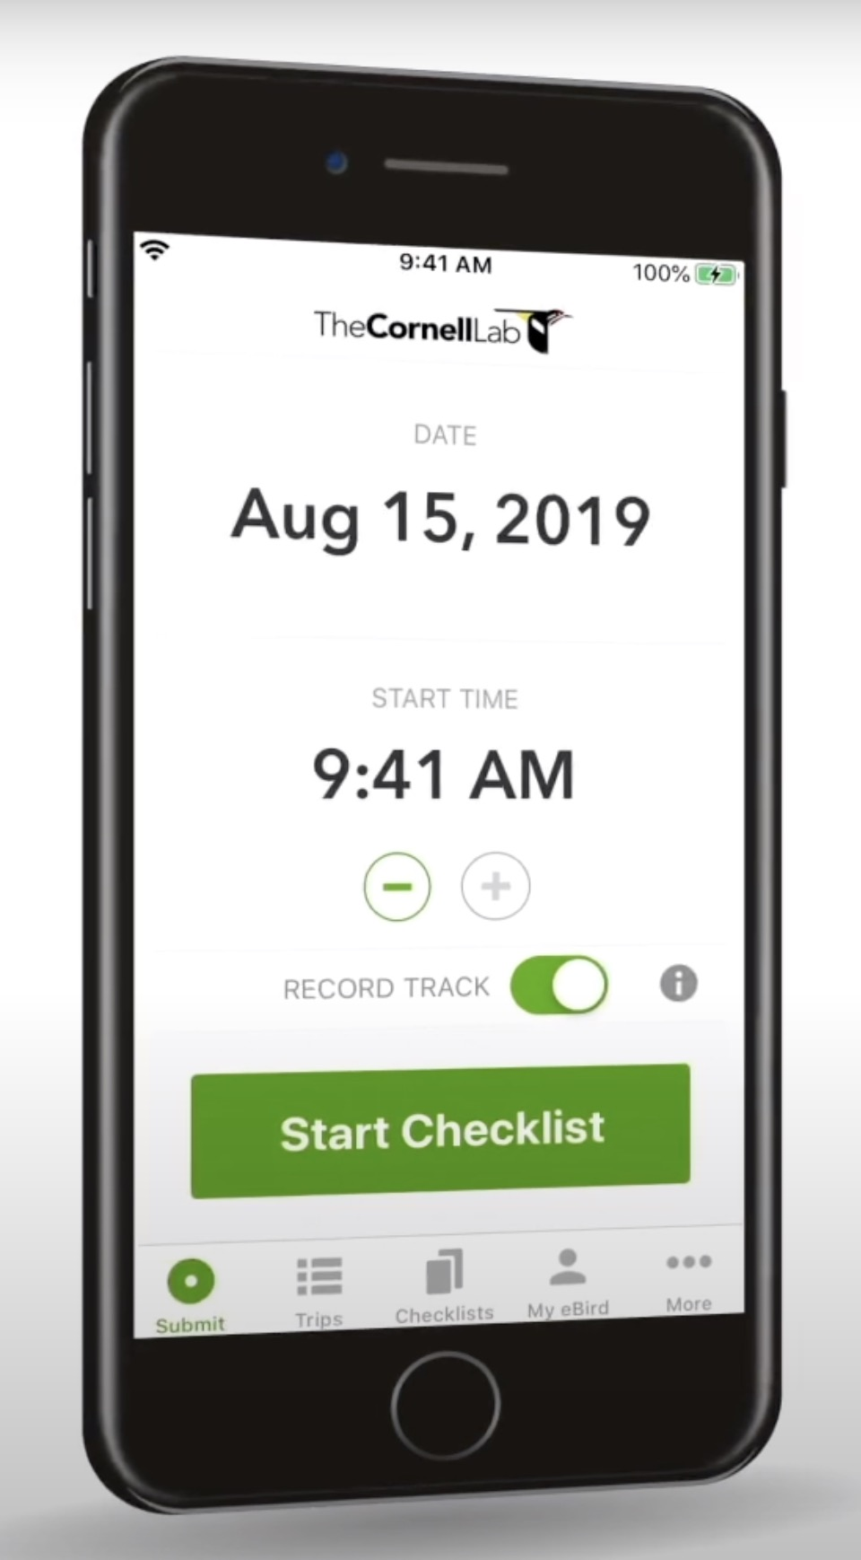
Ways to Share Birds!
Merlin App
eBird App
eBird on a Computer or Tablet
The Great Backyard Bird Count

Slide 4
Merlin Has Options
Sound ID
01
Any of the tools in Merlin work for sharing your birds for GBBC.
Pick your favorite and remember to tap:
Step-by-Step
02
Photo ID
03
This is My Bird!
Explore Birds
04
The Great Backyard Bird Count

Slide 5
Using eBird but new to bird watching?
eBird...
Is best if you know your birds
Has a learning curve
Allows you to count birds
Consider taking the FREE
eBird Essentials Course.
https://academy.allaboutbirds.org/product/ebird-essentials/
The Great Backyard Bird Count

Slide 6
Watch & Count Birds Anywhere!
Yards
Patios/Porches
City Streets
Parks/Preserves
Schools
Nature Centers
Places of Worship
Everywhere there are birds!
Downy Woodpecker by Francis Morgan / Macaulay Library

Slide 7
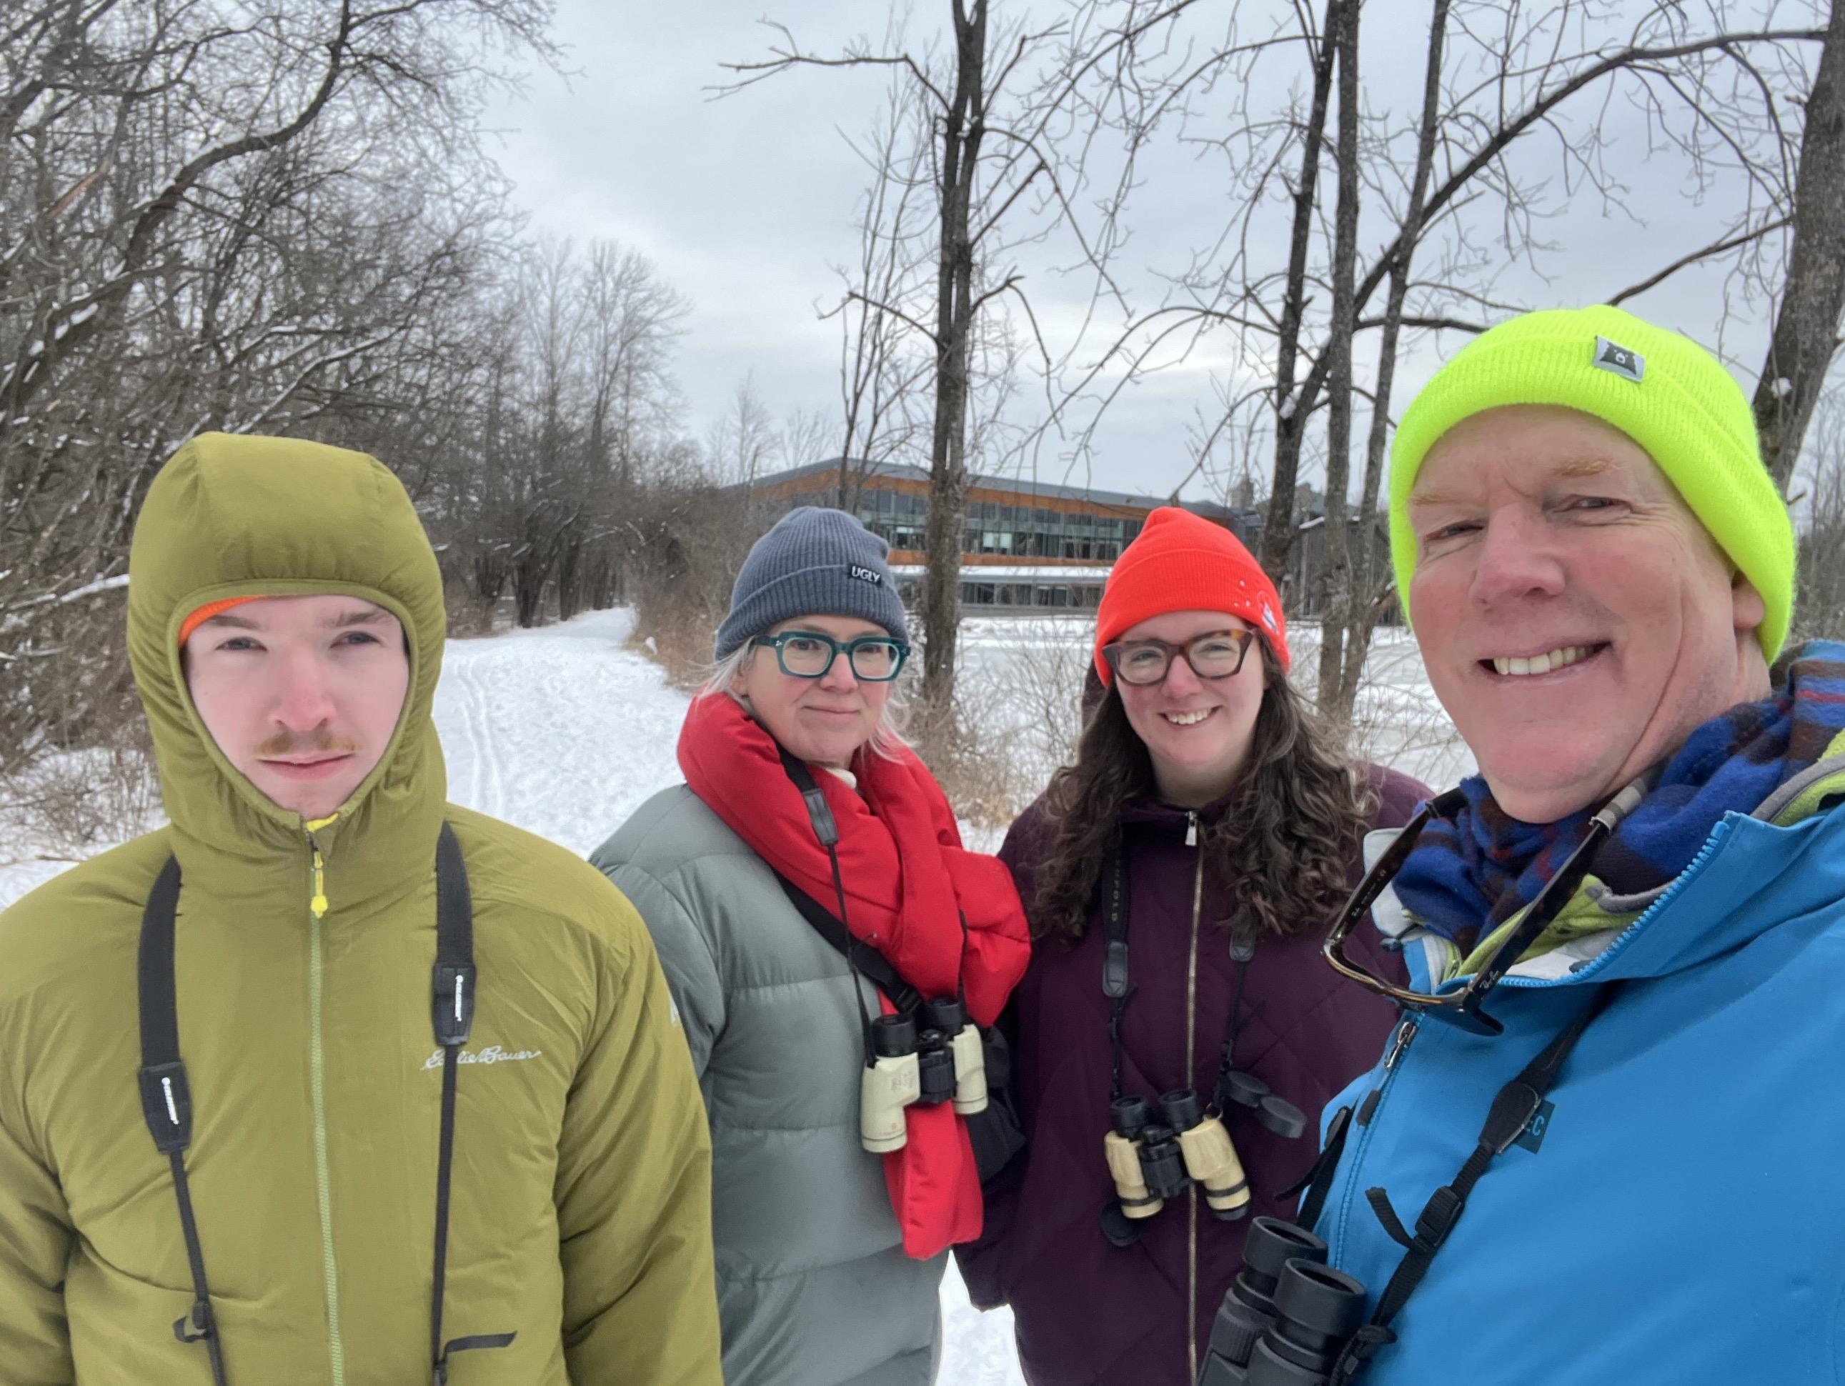
Why Participate?
It’s fun and connects you to nature
01
Long-term records of birds
02
Scientists can’t be everywhere, all the time
03
04
Puts your observations to work for conservation
John Scully in U.S. / GBBC
The Great Backyard Bird Count

Slide 8
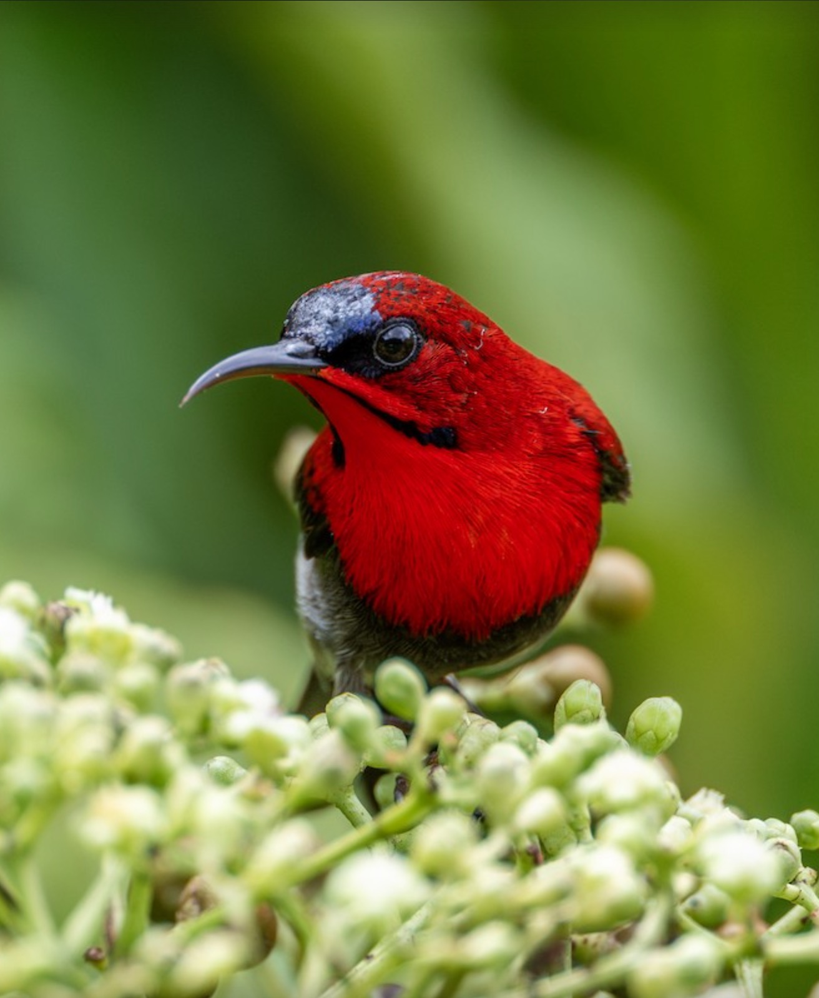
What Do We Learn?
Migration patterns
01
Year-to-year changes
02
Long-term trends
03
Crimson Sunbird in Singapore by Yifei Zheng / Macaulay Library

Slide 9
What Do You Do?
Watch and count birds anywhere for at least 15 minutes
01
Watch longer if you wish
02
Keep track of time / place
03
Best estimate on the number of individuals for each species observed (if using eBird)
04
The Great Backyard Birds Count

Slide 10
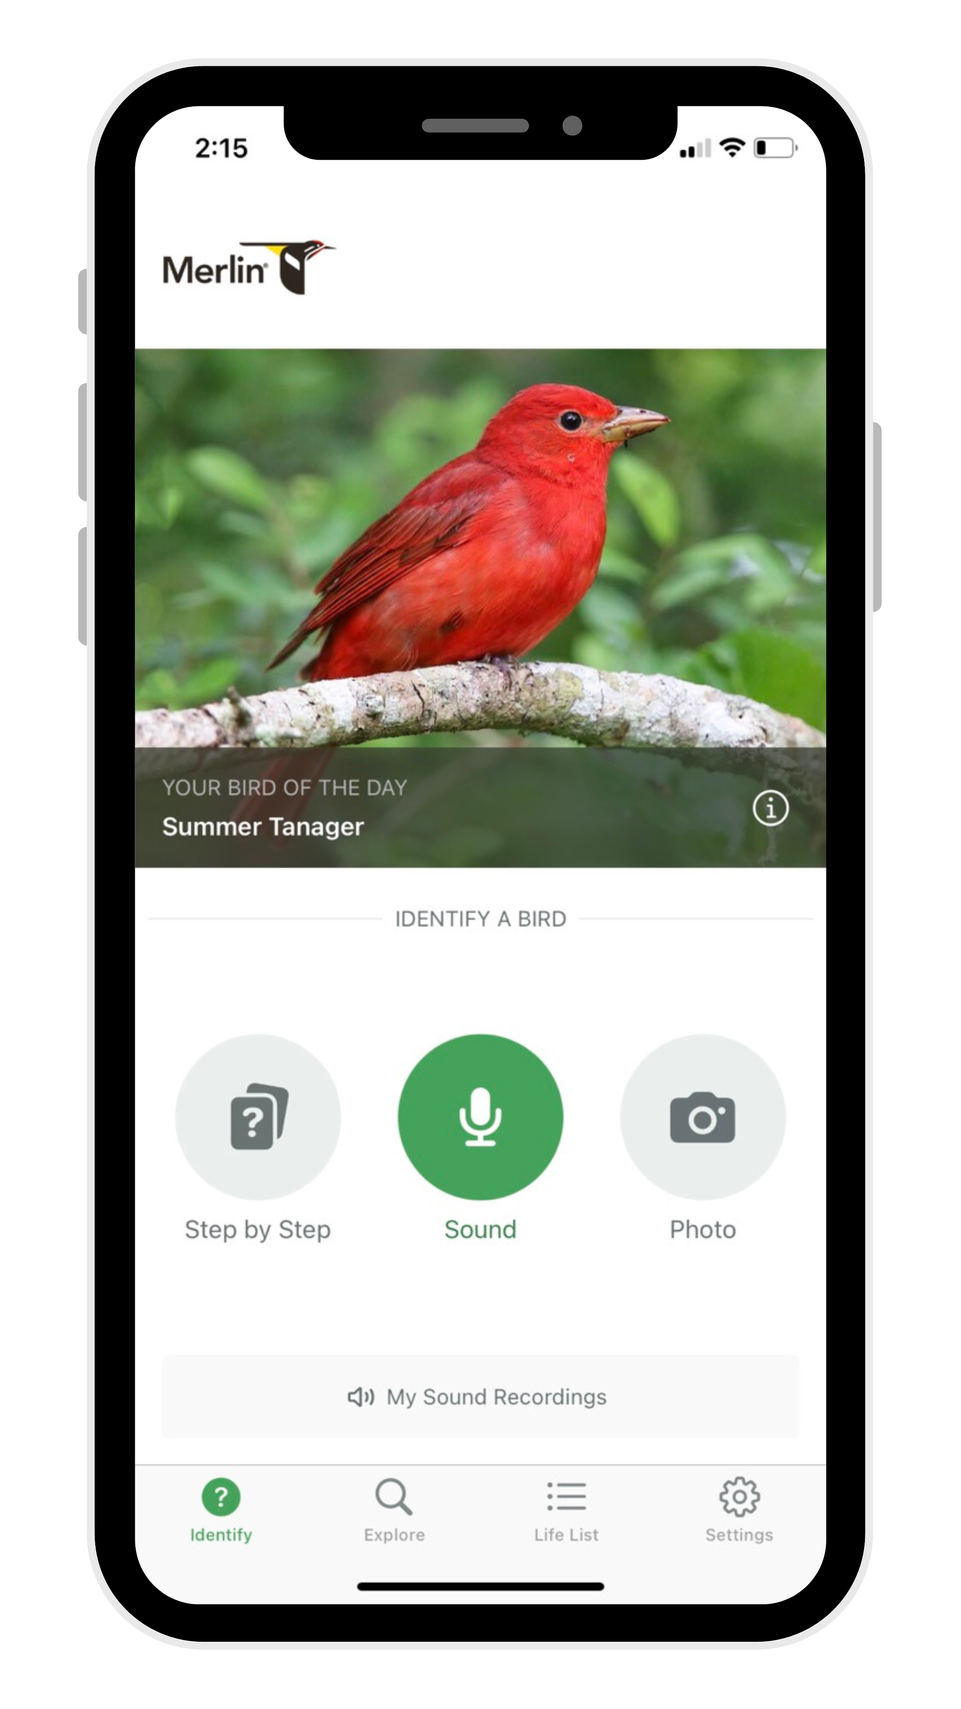
You will need...
Downloaded Tool (Merlin and/or eBird app)
01
Enter/confirm location for each area you watch birds
02
Track amount of time watched and enter (in eBird)
03

Slide 11
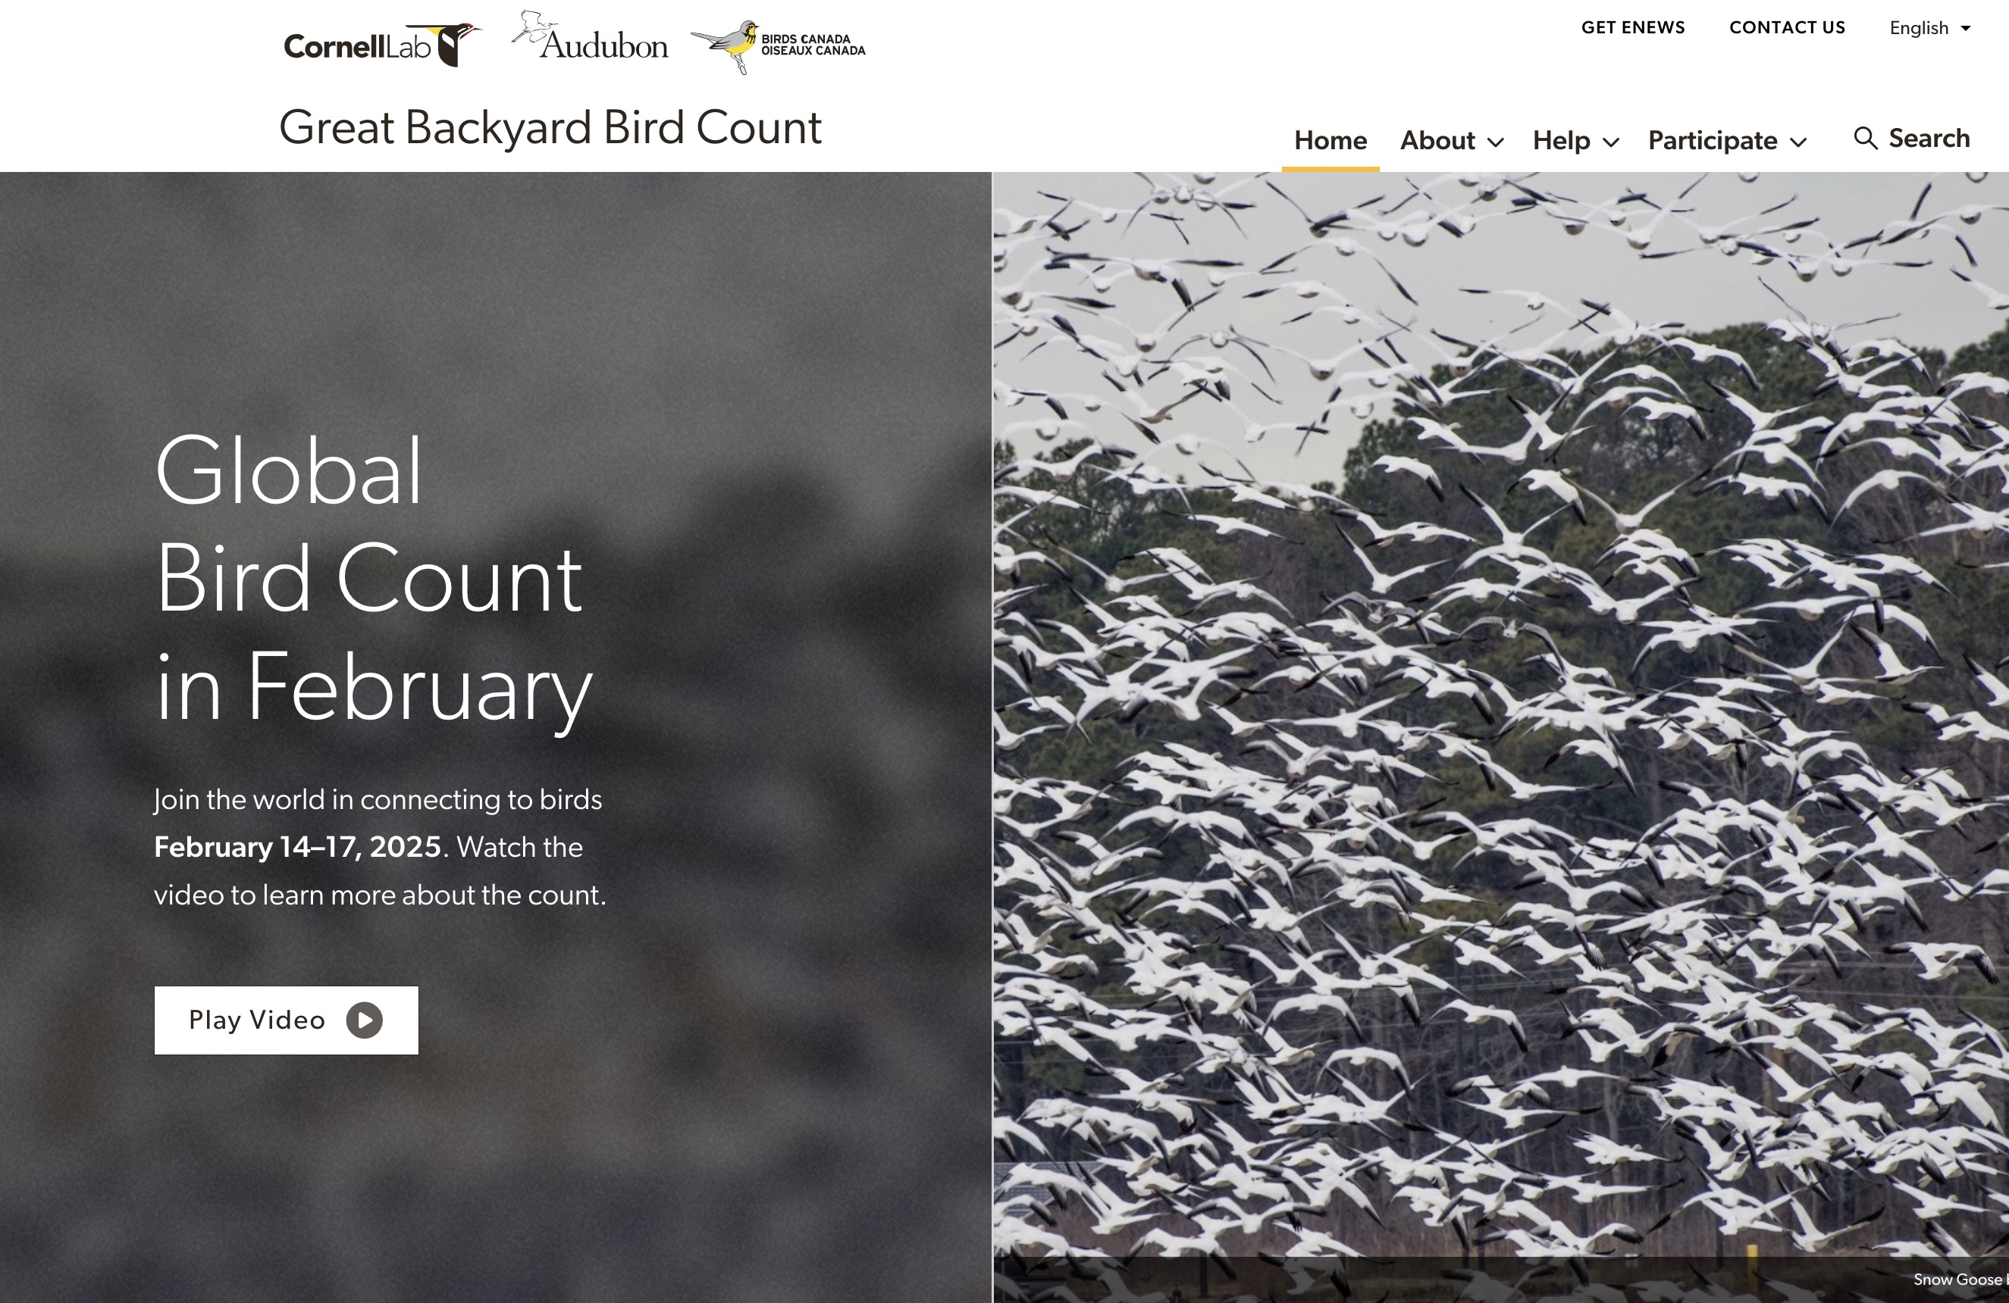
Access Tools to Participate
Visit our website:
Birdcount.org
The Great Backyard Bird Count

Slide 12
Important
If you use Merlin or eBird already, keep doing what you are doing! All entries over 4-days count towards GBBC.
01
New to GBBC or Cornell Lab projects? Create an account. If you have participated in another project (PFW, NW, Bird Academy) use the same username and password.
02
Track amount of time watched and enter (in eBird)
03

Slide 13
For Step-by-Step Directions
Visit our participate page to follow a guide on how to use Merlin or eBird:
https://www.birdcount.org/participate/
Vidhya Sundar in U.S. / GBBC; Anna's Hummingbird by Markus Duhme / Macaulay Library; Alicia Highland in U.S. /GBBC
The Great Backyard Bird Count

Slide 14
After You Submit Your Birds
You can:
Review and edit the list
Share your list with others in your group
Submit another list
Sharp-shinned Hawk by David Wade / Macaulay Library; April Gaydos in Mexico / GBBC; Mrs. Gould's Sunbird (Scarlet-breasted) in Thailand by Wich’yanan Limparungpatthanakij / Macaulay Library
The Great Backyard Bird Count

Slide 15
Thank You https://www.birdcount.org

